Slide 1
CSCI 566: Deep Learning and Its Applications
Jesse Thomason
Lecture 4: Activations, Initializations,
Optimization, and Regularization

Slide 2
CSCI 566 Resources
Website: https://csci566-spring2023.github.io/
Piazza: https://piazza.com/usc/spring2023/csci566/info
GDrive: https://drive.google.com/drive/folders/11YcbSZcJUdRSbrNBWiOs_HM2VkxdNKWS?usp=share_link
Includes spreadsheet with lecture slide + recording links!
Zoom: https://usc.zoom.us/j/95538924150?pwd=TTRBM283VCt4WDFkN1hLMmtrKzdGUT09

Slide 3
Course Project Team Registration
Your 4-person teams should be registered now
If you have not registered your team, fill the form ASAP!
Piazza -> Resources -> Course Project -> Project Team Registration
If you haven’t found a team, come up to the front during the break to find all the other students who haven’t found a team.

Slide 4
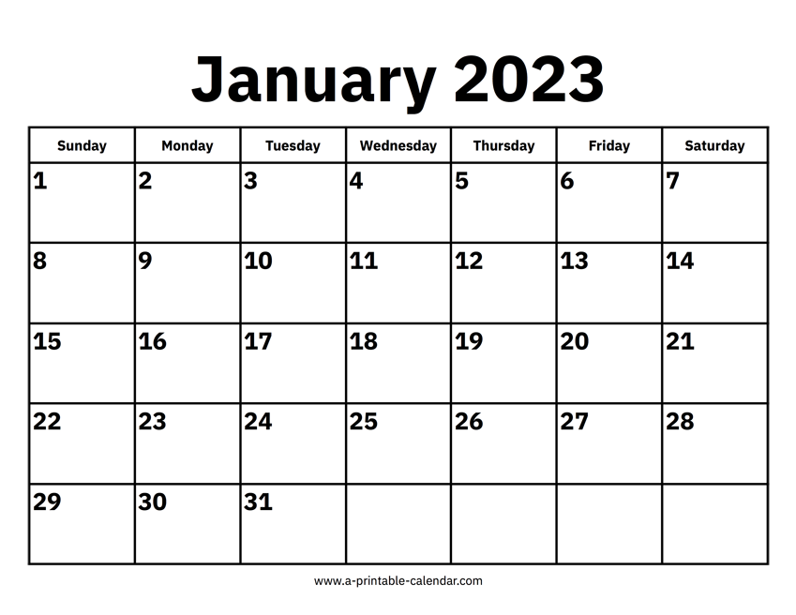
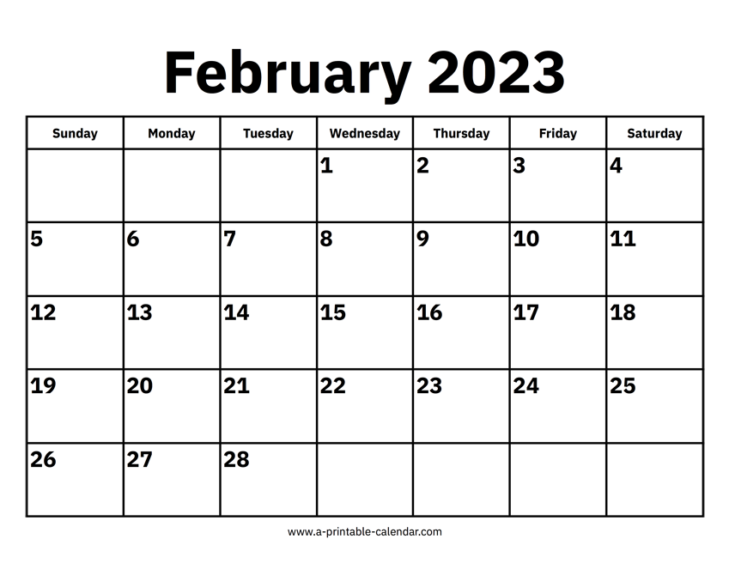

Map to the Midterm
Module 1: Neural Network Basics

Slide 5
[Feb 10] A Look at February Deliverables
Project Teams Formed | Feb 3
Assignment 1 Out | Feb 10
Project Proposal Due | Feb 17
Assignment 1 Due | Feb 24
Midterm Exam | Feb 24

Slide 6
Next Week: Course Project Proposal Due [Feb 17]
Proposal: 5-6 slides on problem (scope & definition) + "today" (status of literature) + challenges + directions to innovate.
Look at the project ideas doc populated by the TAs to get a sense of what material your proposal should cover for problem definition and background
Include what you hope to be your key insight or contribution; what will make your approach unique?
We will share a link to collect the slides.
You will condense these longer, more detailed slides into a single lightning pitch slide for the Project Pitch assignment.

Slide 7
Overview of Today’s Plan
Course organization and deliverables
Any questions before we move on?
Activation Functions and Preprocessing
Optimization and Regularization
Cloud Computing Service Tutorial
Deep Learning Software Tutorial
Coding Assignment 1 Release Briefing

Slide 8
f: X ✕ Θ → Y;
f(x;θ)=y; θ∈Θ for model M
f: X → Y;
f(x)=y
f: ɸ_{x}(X) ✕ Θ → ɸ_{y}(Y);
f(x;θ)=y
f: ɸ_{x}(X) → ɸ_{y}(Y);
f(x)=y
DL enables function approximation for f and is constrained by:
Data representation ɸ
Model architecture M
Loss function L
Optimization algorithm
Training data D
θ*=min_{θ∈Θ}(Σ_{(x,y)}L(f(x;θ), y)))
θ*=min_{θ∈Θ}(Σ_{(x,y)∈D}L(f(x;θ), y)))

Slide 9
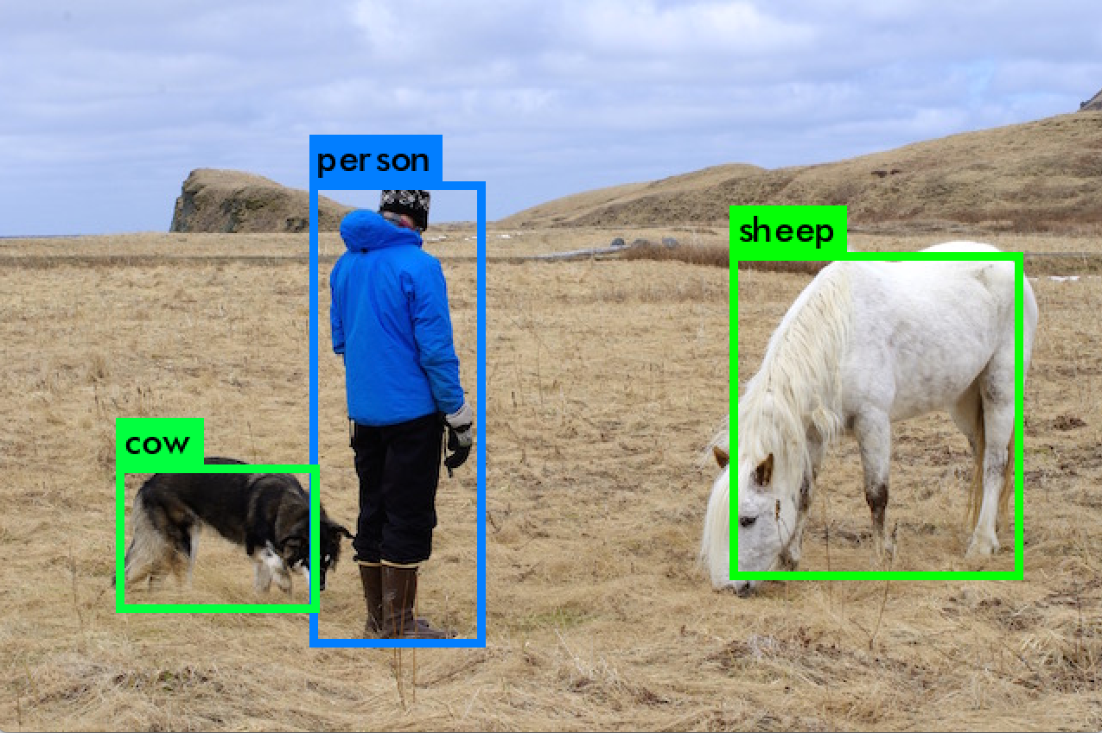
Representations and Models
Input space X?
Pixels in the image
Representation?
ɸ_{x}(X)=R^{W,H,3} RGB or HSV
Output space Y?
Object classes C + bboxes
Representation?
ɸ_{y}(Y) = C ✕ R^{x,y,w,h} ✕ N
What model architecture might you use?
What loss function would you want to optimize?

Slide 10
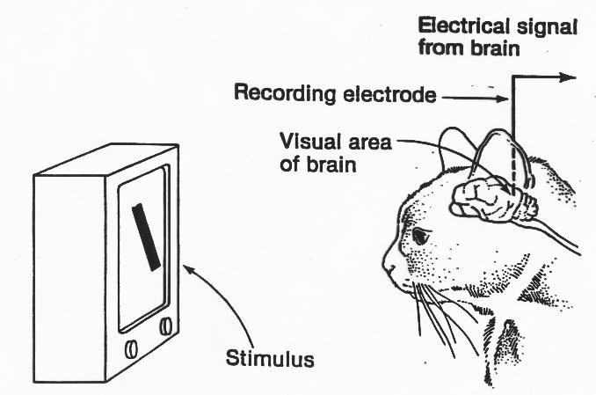
Origins of Convolutional Neural Networks
“They found that particular neurons in the visual cortexes of cats and monkeys—the areas in their brains responsible for processing visual information—didn't respond to simple points of light, but rather to lines, and in particular, lines and contours with specific orientations”
https://hub.jhu.edu/2015/07/14/golden-goose-award-wiesel-hubel/

Slide 11

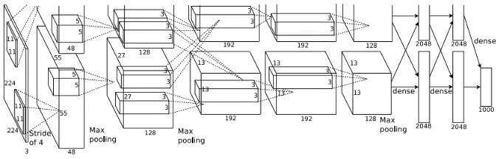
Breaking Down AlexNet
.01 | car
.03 | dog
.63 | person
.11 | airplane
.02 | flower
… | …
Image
Conv
Conv
Conv
Conv
Conv
FC
FC
FC+𝝈
Pool
Pool
Pool

Slide 12
Common Layers in a Deep Convolutional Neural Net
Image
x in our parlance; the vectorized input
Convolutional layer
Pooling layer (in AlexNet, MaxPool)
Fully-connected layer (i.e., perceptron layer)
Softmax layer (fully connected layer + exponentiated normalization)
Each layer is a differentiable function whose input is the output of the previous layer (function)
Conv
Pool
FC
FC+𝝈

Slide 13



Convolutional Layer
5
5
3
f_{c}(x_{A}) = Wx_{A}+b
x_{A}
28
32
28
32
ɸ_{x}( ) = [0, 1]^{(32 x 32 x 3)}
1
x_{A} is a 5x5x3 subset of image tensor x
Filter function f_{c} a learned, linear function over flattened x_{A}
W is 1x(5*5*3), b is size 1, so f_{c} is a single number!
3

Slide 14
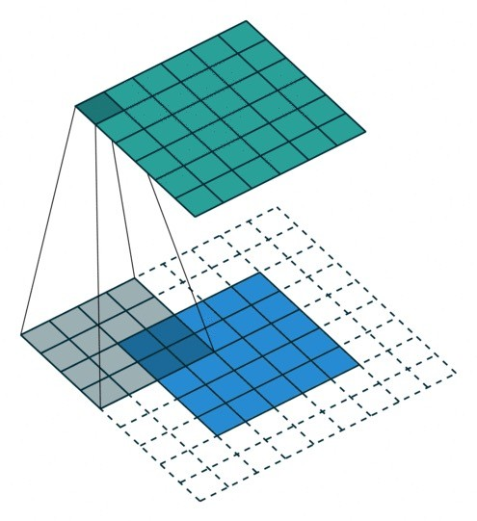
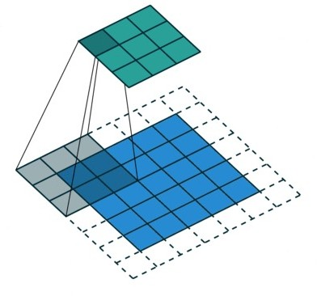
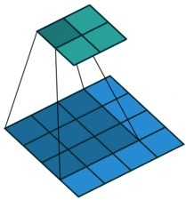
Convolutional Layer Terminology
Padding and Stride
Pad=0; Stride=1
Pad=2; Stride=1
Pad=1; Stride=2
Kernel size?
What to pad with?
Effect of stride?
3x3; lose 2 w/h
Zeros common
Sparser output

Slide 15
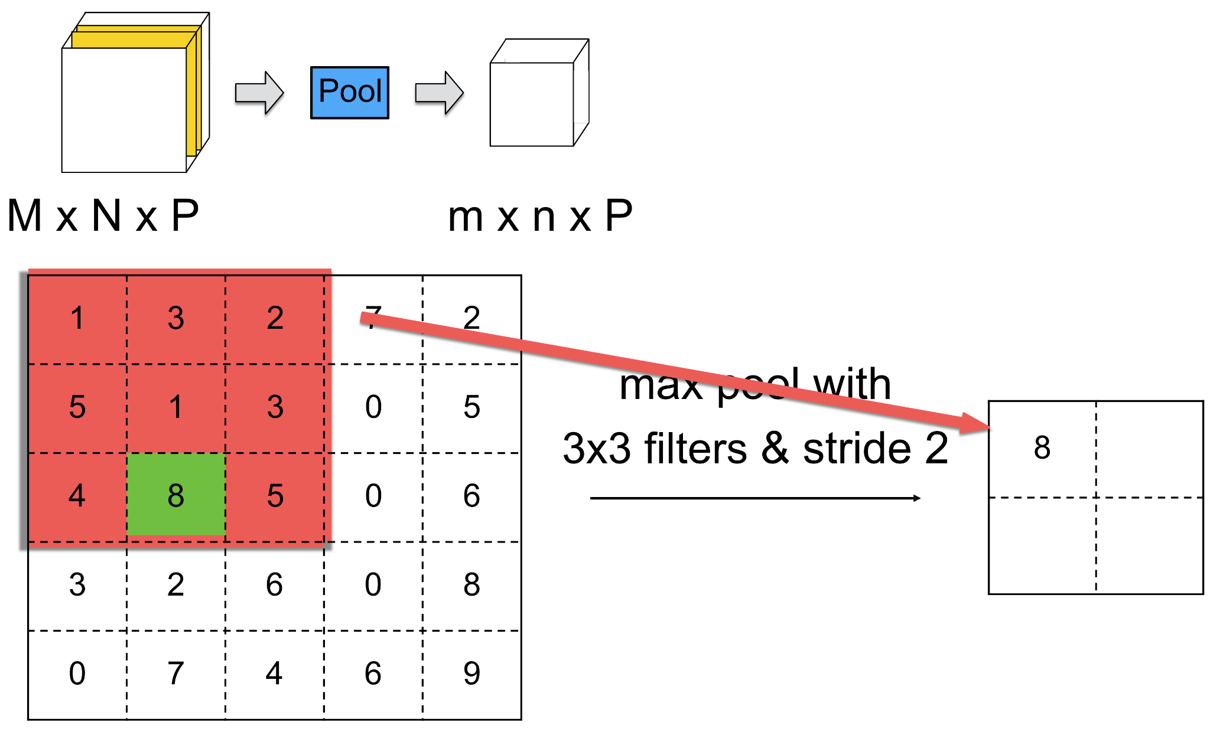
Max Pooling Layer

Slide 16



Image Classification with a Conv and Pool Layers
A neural network is a composition of a composition of matrix multiplications and non-linear transformations. What’s missing here?
ɸ_{x}( ) = [0, 1]^{(w x h x 3)}
|C|
.01 | car
.03 | dog
.63 | person
.11 | airplane
.02 | flower
… | …
w’
w
h’
w’’
W^{(|C| x w’’*h’’*4)}
h
Conv
Pool
FC+𝝈
h’’
4
4
3
1
f_{c}(x_{A}) = W_{c}x_{A}+b_{c}
f_{p}(f_{c}(•)) = max(f_{c}(•))
FC(f_{p}(f_{c}(•))) = W_{out}f_{p}(f_{c}(•)) + b_{out}

Slide 17













Why Utilize Non-Linearities in a Deep Neural Network?
Without nonlinear activations,
multiple layers are reduced to one matrix multiplication.
G^{h2 x h1}
H^{|Y| x h2}
F^{h1 x |X|}
Q^{|Y| x |X|}
X
Y
X
Y
Define Q^{|Y| x |X|} = HGF
Then Y=QX
Y=H(G(F(X)))

Slide 18
Why Utilize Non-Linearities in a Deep Neural Network?
G^{h2 x h1}
H^{|Y| x h2}
F^{h1 x |X|}
X
Y
F(x) = a(W_{F}(x)+b_{F})
G(x_{h1}) = a(W_{G}(x_{h1})+b_{G}
Activation function a is non-linear and not expressible as a matrix multiplication.
Y=H(G(F(X)))

Slide 19
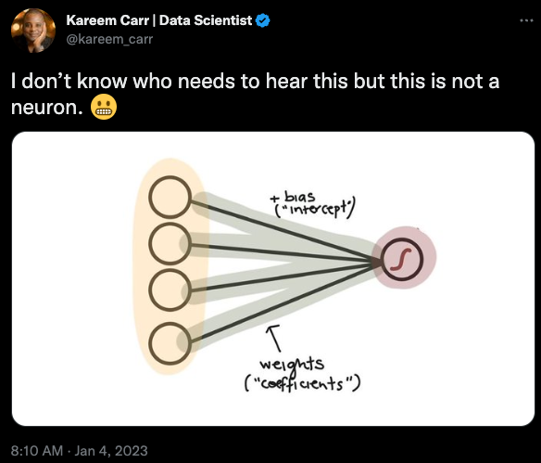
Deep Learning Borrows* Terminology from Neuroscience
Brains are complex, interconnected networks of neurons
Neurons are connected via dendritic spines and communicate through chemical and electrical synapses
“Artificial neural networks” was an early term coined for binary variables “activated” by signals from other binary variables
In a “feed forward neural network”, those variables are activated in order from input to output
A “deep neural network” has sequenced input/output layers
*Abuses, one might say.

Slide 20
Activation Functions
ɸ_{x}(x)=x
Wx
Wx+b
a(Wx+b)
b₁

Slide 21
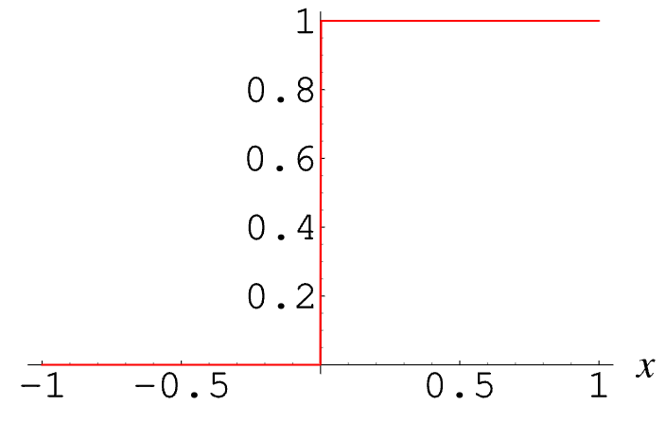
Activation Functions
ɸ_{x}(x)=x
Wx
Wx+b
a(Wx+b)
= a(W_{1,1}x₁ + W_{1,2}x₂ + W_{1,3}x₃ + W_{1,4}x₄ + W_{1,5}x₅+b₁)
If we think about a “neuron” as inspiration, the output after a should be 1 if W_{1,1}x₁ + W_{1,2}x₂ + W_{1,3}x₃ + W_{1,4}x₄ + W_{1,5}x₅+b₁ exceeds a threshold and 0 else.
What’s the “problem” with defining a this way?
b₁
e.g., a(x) = {1 if x>0 else 0}
To perform backpropagation, we need differentiable functions with non-zero gradients.

Slide 22
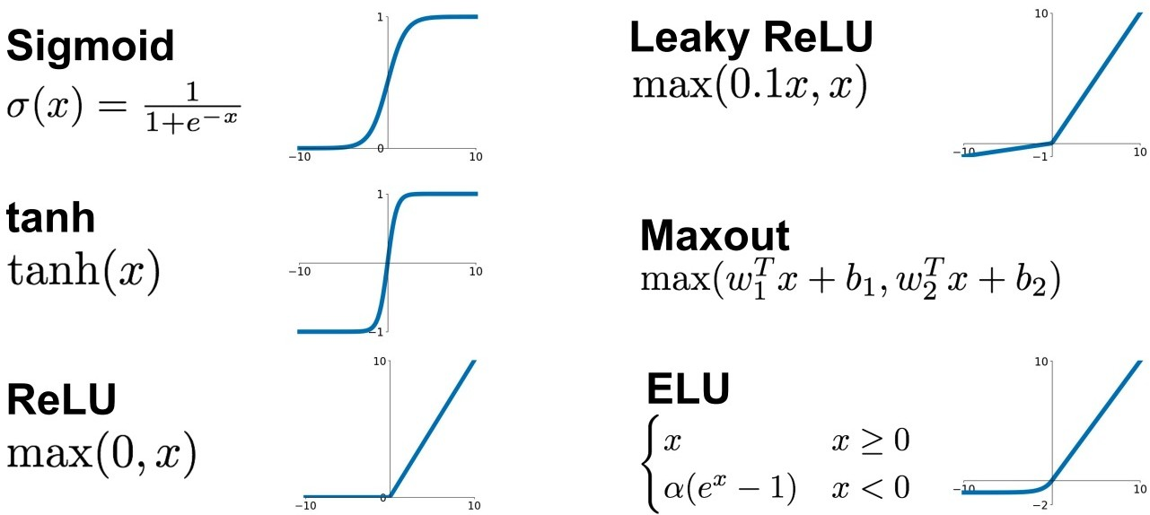
Activation Functions

Slide 23
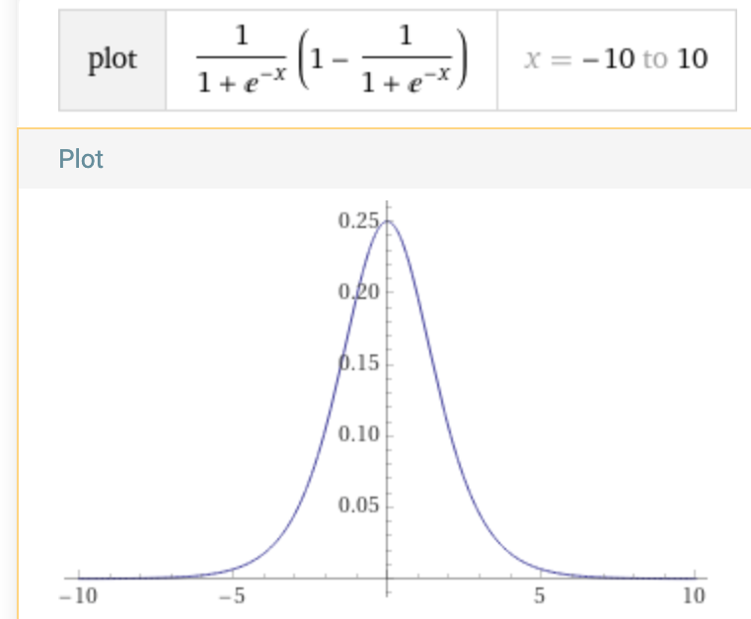
Activation Functions: Sigmoid
Note: annoyingly, your prof (me) uses 𝝈 to denote softmax layers but also sigmoid activations. Sorry!
Advantages:
“Looks” a lot like our step function! Bounded in [0,1]
Disadvantages:
Derivative is near 0 almost everywhere
Learning can become prohibitively slow, especially if multiple sigmoids are involved across layers!
What is ^{d}/_{dx}𝝈(x)?
^{d}/_{dx}𝝈(x) = 𝝈(x)(1−𝝈(x)) [derivation]

Slide 24
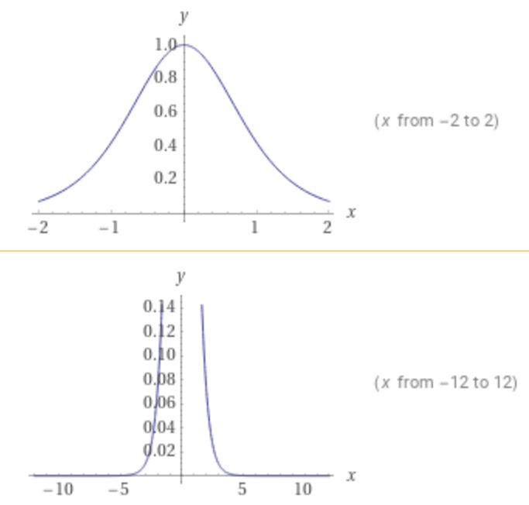
Activation Functions: Hyperbolic Tangent
Advantages:
“Looks” a lot like our step function! Bounded in [-1,1]
Disadvantages:
Derivative is near 0 almost everywhere
What is ^{d}/_{dx}tanh(x)?
^{d}/_{dx}tanh(x) = sech²(x)

Slide 25
Activation Functions: Rectified Linear Unit (ReLU)
Learning can stall if activations are below zero because gradient stops flowing.
Advantages:
For x>0, reliable and cheap to calculate gradient
What is ^{d}/_{dx}max(0, x)?
^{d}/_{dx}max(0, x) = {1 if x>0; else 0}
Disadvantages:
Derivative is exactly 0 for x<0
Output in the positive direction is unbounded

Slide 26
Activation Functions: Rectified Linear Unit (ReLU)
Advantages:
Reliable and cheap to calculate gradient
What is ^{d}/_{dx}max(0.1x, x)?
^{d}/_{dx}max(0.1x, x) = {1 if x>0; else 0.1}
Disadvantages:
As with ReLU, outputs are still unbounded and could cause problems in later layers

Slide 27
With These Layers, We Can Compose AlexNet!
ReLU
ReLU
ReLU
ReLU
ReLU
ReLU
ReLU
Image
Conv
Conv
Conv
Conv
Conv
FC
FC
FC+𝝈
Pool
Pool
Pool

Slide 28
What Assumption Do Our Activation Functions Make?
Our activation functions are all on their best behavior when the input x is close to zero.

Slide 29
Weight Initialization: Zeros
Since input to activation functions behaves well around zero, how about we start all our weights at zero?
Initialize all weight matrix W and bias vector b parameters are initialized to zero for all layers (e.g., fully connected, CNN filters, etc.):
What is the effect on the final output vector?
Guaranteed to be all zeros for any input!
Gradients will vanish; model can’t learn

Slide 30

Weight Initialization
We want well-behaved, random initial parameter values that are near zero but not uniformly zero
What’s the easiest way to accomplish that goal?
Draws from a Gaussian distribution!
What’s a good value for μ?
μ=0
What’s a good value for 𝜎²?
0<𝜎²<1, e.g., 𝜎²=0.01

Slide 31
Weight Initialization: Gaussian Distribution
Draws from a Gaussian distribution
Advantages:
Easy to implement
Disadvantages:
Hyperparameter we need to set: 𝜎²
If the weights are too small, the activation signals shrink quickly during training
If the weights are too large, the activation signals explode during training

Slide 32
Weight Initialization: Controlling Activation Variance
Glorot and Bengio argue that when the variance of the layer outputs (and hence the downstream layer inputs) is not ≈1, depending on the activation function, models will converge more slowly, especially when the layer output variance is <1
“Fixes” that initialize parameters to encourage layer outputs whose variance is ≈1 depend the activation function
Understanding the difficulty of training deep feedforward neural networks

Slide 33
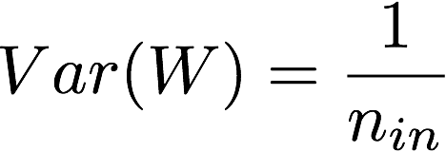
Weight Initialization: Controlling Activation Variance
Activation functions with centered average (sigmoid; tanh):
Set the variance to inverse of the number of input units that contribute to each logit in the layer [Glorot Initialization]
Activation functions with unbounded average (ReLU):
Because average activation is a higher positive number, need to adjust up to Var(W)=²/_{n_in} [Kaiming initialization]
Xavier Glorot Initialization in Neural Networks — Math Proof [blog post on Glorot]
Delving Deep into Rectifiers: Surpassing Human-Level Performance on ImageNet Classification [Kaiming He paper]
L11.6 Xavier Glorot and Kaiming He Initialization [Brief Lecture on Differences Between These]

Slide 34
What Assumption Do Our Activation Functions Make?
Our activation functions are all on their best behavior when the input x is close to zero.
What aspect of the path from input to output won’t weight initialization alone help with?

Slide 35
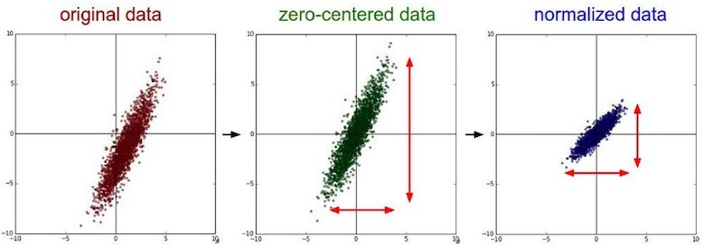
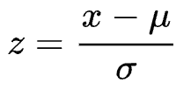
Input Representation and Data Preprocessing
We can make our input representation ɸ a function that considers the entire training dataset to standardize it
Zero-centering: shift the data to have features with mean 0
Normalization: adjust features to have variance 1
(e.g., z-score normalization)

Slide 36
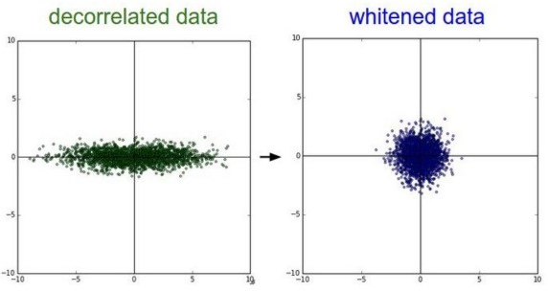
Input Representation and Data Preprocessing
We can make our input representation ɸ a function that considers the entire training dataset to standardize it
Remove correlations between input features via dimensionality reduction (e.g., PCA)
PCA Whitening [blog]

Slide 37
Overview of Today’s Plan
Course organization and deliverables
Activation Functions and Preprocessing
Any questions before we move on?
Optimization and Regularization
Cloud Computing Service Tutorial
Deep Learning Software Tutorial
Coding Assignment 1 Release Briefing

Slide 38


Gradient Descent
Vanilla (true) Gradient Descent
Estimate θ over the whole dataset
Stochastic Gradient Descent (SGD)
Estimate θ at a random datapoint
Minibatch Gradient Descent
Estimate θ as an average over a random batch of training data
Commonly we use “SGD” to refer to this setup

Slide 39
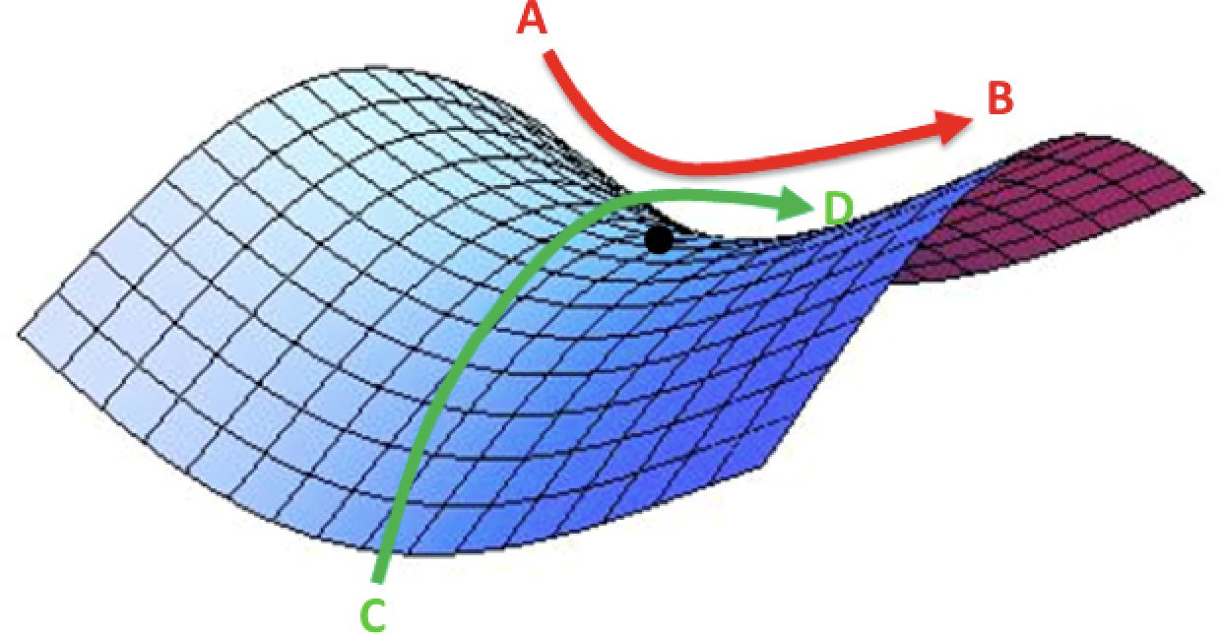
Saddles and Local Minima
Gradient descent drives the parameters θ to towards the closest low point in the loss space
Gets “stuck” if the loss is locally minimal (basin) or the gradient goes in orthogonal directions across dimensions (saddle)
θ
θ
θ
local minimum
saddle points

Slide 40


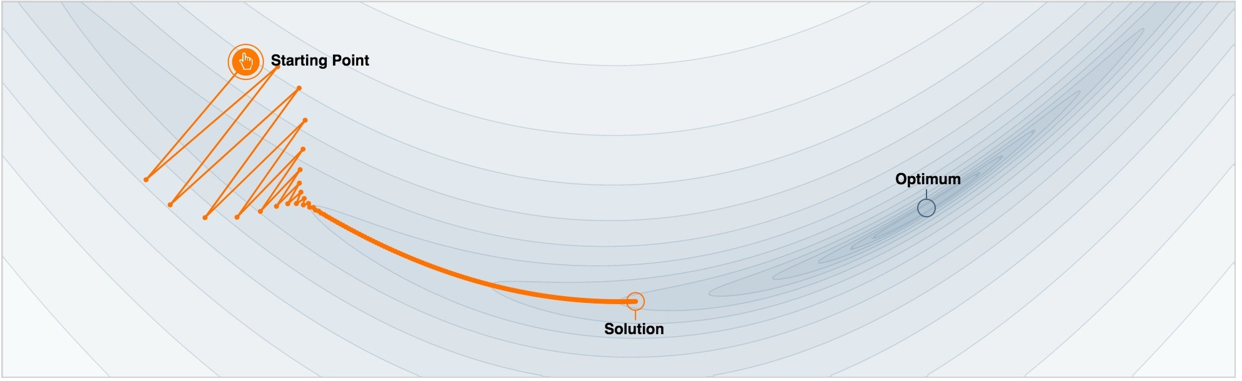
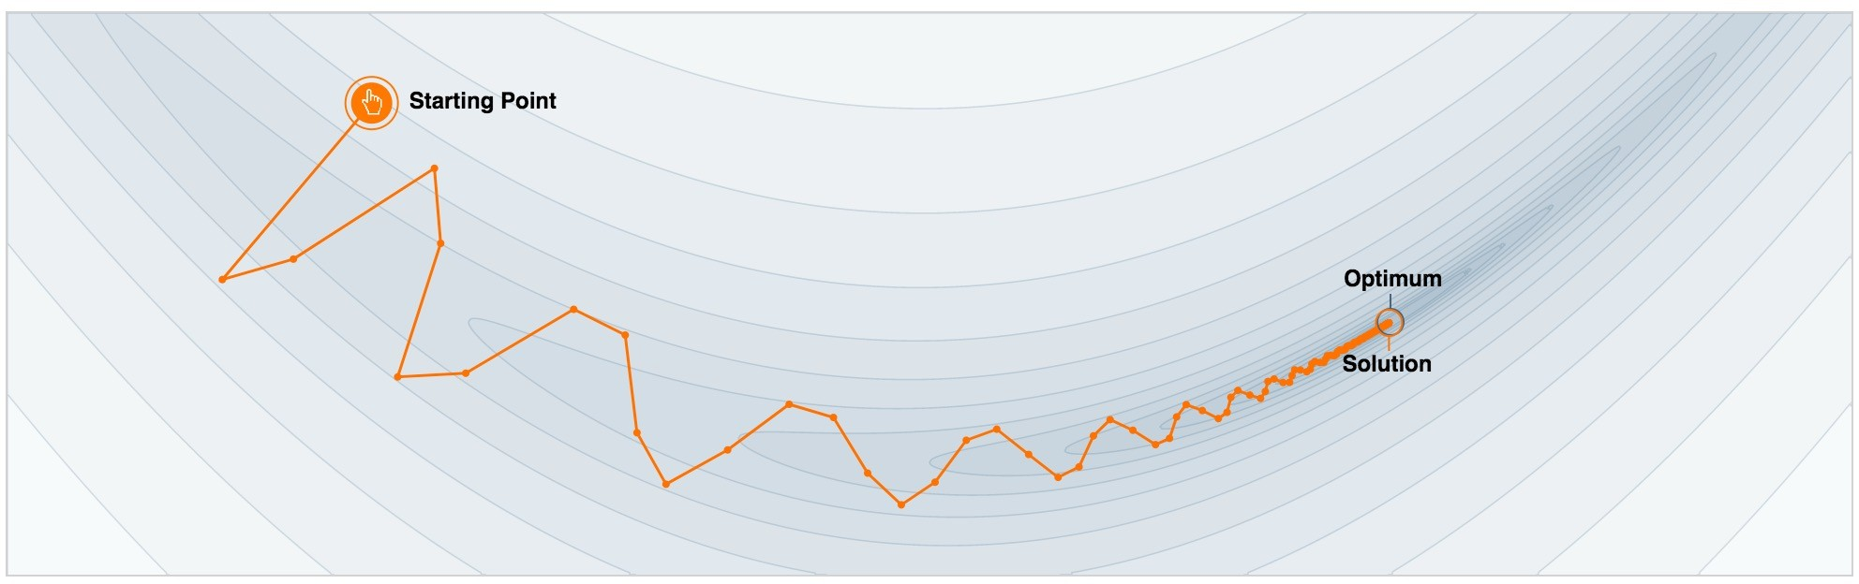
Gradient Descent with Momentum
Consider the history:
Add a fraction 𝛄 of the update vector of the past time step to the current update vector
GD without momentum
GD with momentum

Slide 41
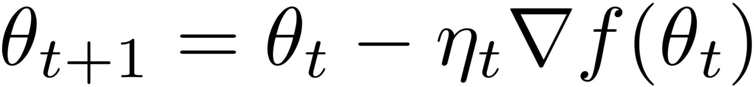
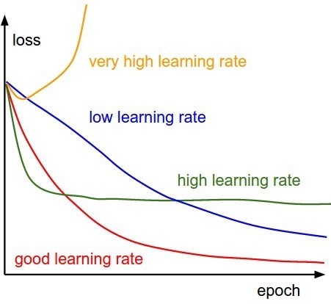
Optimizer Parameters: Learning Rate
How fast or slow we update the model parameters
If the learning rate is too large, the model parameters “explode” (move too fast; gain in magnitude)
If the learning rate is too small, the model parameters move slowly and may be unable to escape local minima

Slide 42
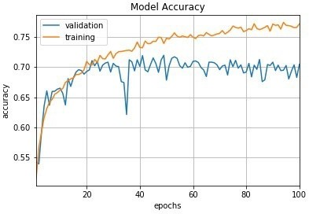
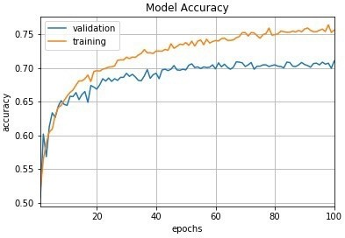


Optimizer Parameters: Learning Rate
Learning rate schedulers change the LR during training
Constant
Time-based decay

Slide 43
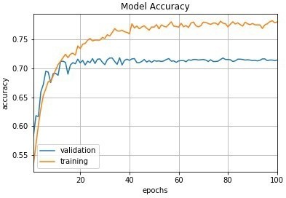
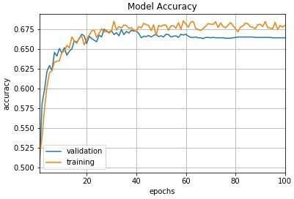
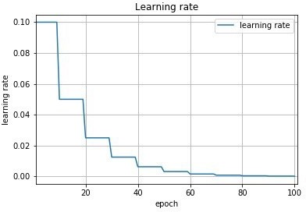
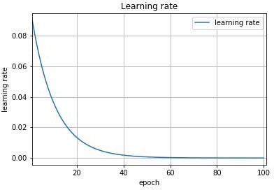


Optimizer Parameters: Learning Rate
Step decay
Exponential decay

Slide 44
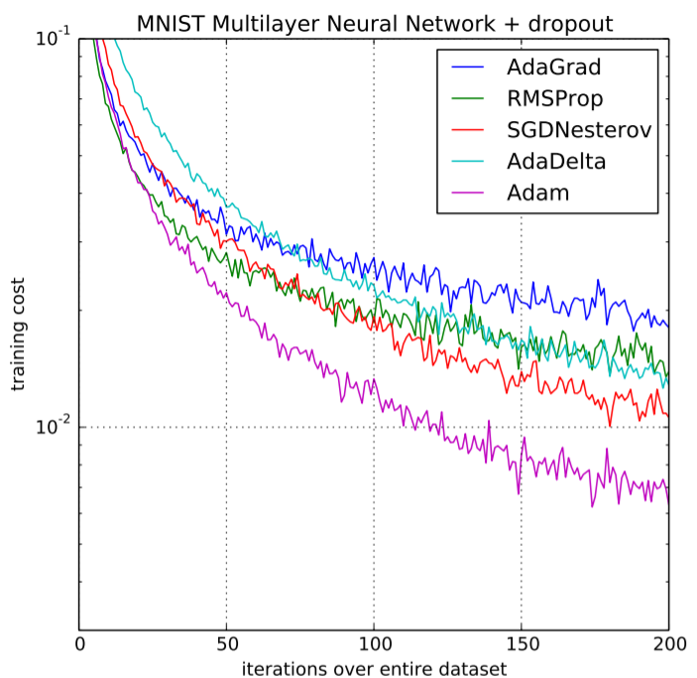
Optimizer Selection In Practice
Aside from tutorial code, you probably haven’t seen “SGD” as the selection for an optimizer
SGD with momentum is the backbone of most optimizers, with adaptive learning rate schedulers cooked in
So which optimizer is best?
It depends!
In practice, the optimizer and its parameters are hyperparameters you’ll jitter around when training a network

Slide 45




Parameter Regularization During Training
We can add a regularization “penalty” to our loss L
L1 parameter regularization
L2 parameter regularization
L1+L2 parameter regularization

Slide 46
























Implicit Ensemble Models: Dropout
At each iteration, randomly shutdown some neurons with a certain probability (usually 0.5)

Slide 47
Implicit Ensemble Models: Dropout
At each iteration, randomly shutdown some neurons with a certain probability (usually 0.5)
Intuition:
Forces the network to have a redundant representation
Same pieces of information are “stored” in multiple different neurons
Training a bunch of small models that share parameters
Each binary mask is one such “small model”
At inference time, these models are “ensembled”

Slide 48
Training Versus Inference Considerations for Dropout
If we randomly drop 0.5 nodes during training time but use all during test time, what might go wrong?
Test time inputs at each layer will be, on average, x2 what was seen at training time!
To compensate, during training time we apply an inverted dropout correction
At training time, for every node not dropped out, increase its output by a magnifying factor of ¹/_{(1-d)} for d probability of dropping each unit; e.g., x10 for dropout 0.9

Slide 49
Training Versus Inference Considerations for Dropout
To compensate, during training time we apply an inverted dropout correction; e.g., for dropout value 0.35:
1/(1-.35) = 1.54
Weight masks: a*0 [drop] a*1.54 [keep]

Slide 50
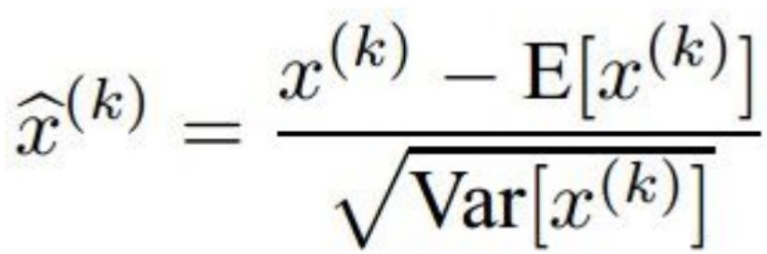
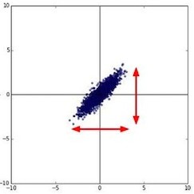


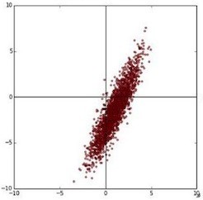









Normalization Between Layers
After each layer, the distribution of activation signals changes (Internal covariate shift)
As a network becomes deeper, distribution shifts more
Just as we preprocess the input data with our representation function to make features well-behaved, we can consider re-normalizing outputs per layer

Slide 51
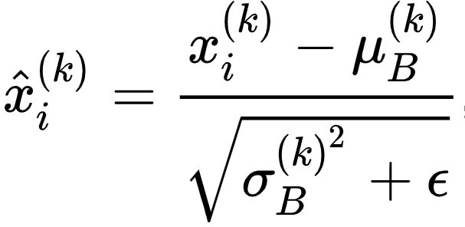
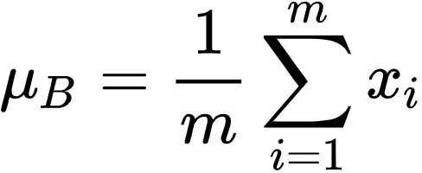
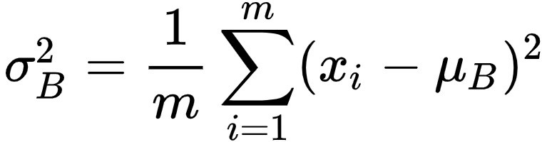
BatchNorm Layer
At training time, compute the estimated mean and variance of the activations of a layer across the current batch
How could we make this transformation a little more flexible?
Introduce learnable parameters to the BatchNorm Layer that enable scaling and shifting individual input indices
Batch Normalization: Accelerating Deep Network Training by Reducing Internal Covariate Shift [paper]

Slide 52
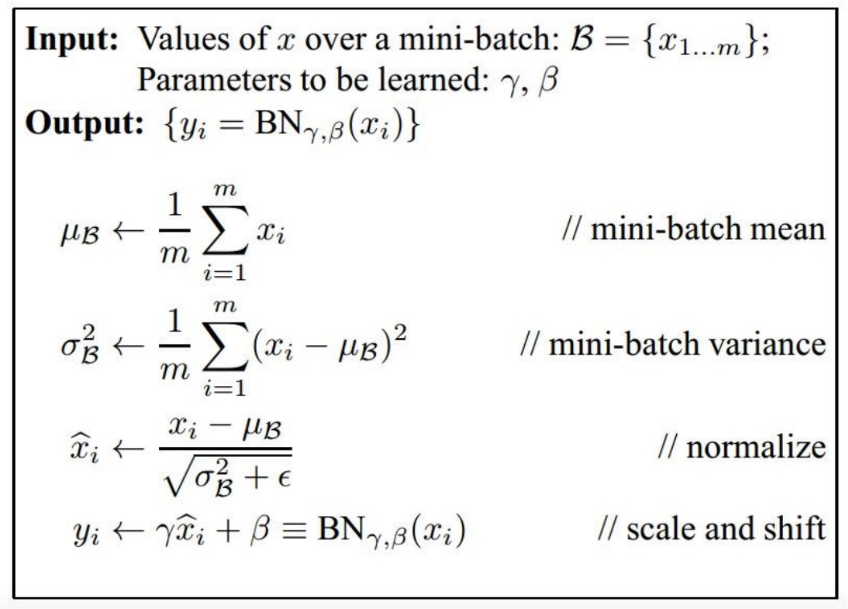
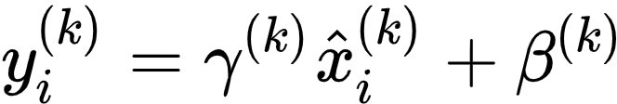
BatchNorm Layer
At inference time, we still need to calculate mean/var of the activations. Should we do it over the batch?
Gamma and Beta are learnable vectors
These params allow the transformed input to have flexible, learned mean & var
BatchNorm layer is differentiable
No! Might be out of expected distribution. Use empirical averages from training data!
Batch Normalization: Accelerating Deep Network Training by Reducing Internal Covariate Shift [paper]

Slide 53
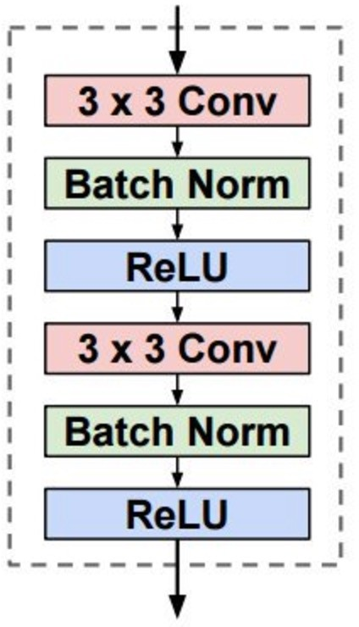
BatchNorm Layer
Usually added after convolutional layers or fully connected layers but before non-linearities
Why?
Point of BatchNorm is to help data get into a space where the activation function behaves well
Perceptual Losses for Real-Time Style Transfer and Super-Resolution [paper]

Slide 54
Overview of Today’s Plan
Course organization and deliverables
Activation Functions and Preprocessing
Optimization and Regularization
Any questions before we move on?
Cloud Computing Service Tutorial
Deep Learning Software Tutorial
Coding Assignment 1 Release Briefing

Slide 56
Action Items for You
If you have not registered with a team, do so ASAP; the registration is currently a week late
Start firming up your project proposal ideas and drafting your slides; these proposal slides are due to us in a week
Coding Assignment 1 will be discussed by TAs and is due two weeks from today
Keep in mind also that the midterm exam will be in two weeks; the exam will be mostly multiple choice and submitted via a google form; it must be taken during the class period

Slide 57
CSCI 566: Deep Learning and Its Applications
Jesse Thomason
Lecture 4: Activations, Initializations, Optimization, and Regularization

